Slide 1
Developing teacher qualities deliberately
Adrie Visscher
ELAN, vakgroep Docentontwikkeling

Slide 3
A few questions
1. How much do teachers actually matter?
2. How do they develop themselves?
3. How do you become an expert?
4. Implications for training teachers?

Slide 4
ad 1: Teacher impact on student achievement
Student: 50-60%
School leader, school organization, peers: 10-15%
Teacher: 10-15%
Strong, malleable factor!

Slide 5
ad 1: Teacher impact on student achievement
Least effective teacher: 0,5 school year learning gain
Most effective teacher: 1,5 school year learning gain
Student has (much) bad luck or luck!

Slide 6
ad 2: Teacher career in terms of effectiveness
Growth towards average effectiveness level takes long
Support from professional environment helps
After 25 years: less impact on students

Slide 7
ad 2: Development basic didactical skills
Complex didactical skills: problem during whole career

Slide 8
ad 2: So, it would be fantastic if …
Sooner competent and effective
Growth in basic skills continues
Mastery complex didactical skills
Low probability bad luck: less variation, higher average

Slide 9
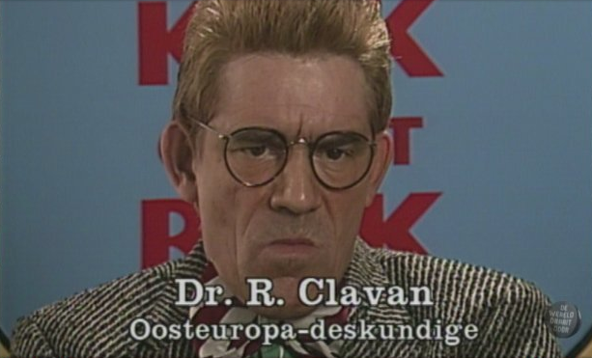
ad 3: How does one become an expert?
Notes:
Prof werkomgeving: safe, orederly, samenw, support SL, resources to improve en bruikbare lkr evaluaties! Weinig switchen tussen vakken en leerjaren

Slide 10
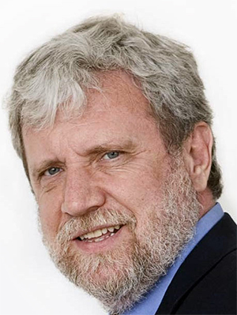
ad 3: How does one become an expert?
Not by repeating what is mastered already
By practice and experience: natural ceiling (‘okay plateau’)
Without deliberate practice no exceptional skills
Developing mental models
Notes:
Prof werkomgeving: safe, orederly, samenw, support SL, resources to improve en bruikbare lkr evaluaties! Weinig switchen tussen vakken en leerjaren

Slide 11
ad 3: Principles Deliberate Practice
1. Have and keep a strong motivation to improve
2. Out of comfort zone: compare with ideal
3. Precise improvement goal
4. Long term practice: short but intense
5. Coach: ideal behaviour, learning tasks, feedback
e

Slide 12
ad 4: Translated to teacher training?
In continuous learning progression focus on professional core skills
Standards for professional skills
Learning-theoretical foundation
Feedback instruments

Slide 13
ad 4: Deliberate Practice & Four Components Instructional Design (4C/ID)
Professional standards <-- cognitive task analysis
Learning-theoretical foundation:
- whole-task-approach
- from simple to complex
- diminishing support

Slide 14
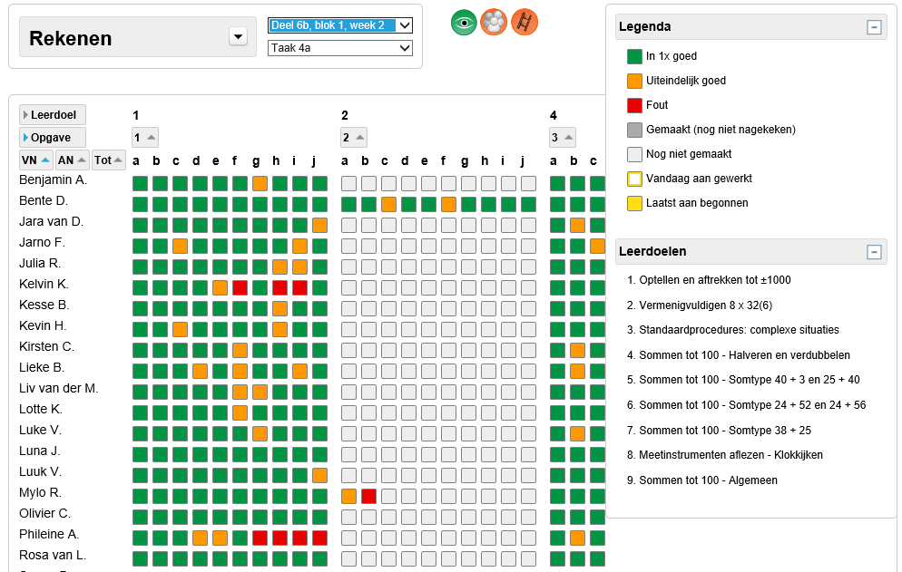
ad 4: How this is done in our ELAN-projects
Four cognitive task analyses (with Maastricht Univ.)
Differentiation: traditional and digital
Formative evaluation
Basis for training design (4C/ID)
Effect evaluation

Slide 15
ad 4: Feedback instruments
How can a teacher learn where he/she can improve?
Self-evaluations autonomous professionals?
Not such a good idea

Slide 16
"All the women are strong, all the men are good looking,
and all the children are above average."

Slide 17
ad 4: Self-evaluations in general
(Kruger & Dunning, 1999)
Often not aware of the need for improvement
“It takes one to know one”

Slide 18
ad 4: Research by the Dutch School Inspectorate
Teachers:
positive image of their basic didactical qualities
Schools:
Little data and policy regarding their didactical skills
“Everyone needs quality feedback to improve”

Slide 19
ad 4: Feedback instruments
Lesson observations: presupose much; many ‘tips’
Student perceptions: many observations; few ‘tips’
Different perspectives on teaching quality

Slide 20
ad 4: Technological opportunities for feedback
For lesson observations:
For student perceptions:

Slide 21
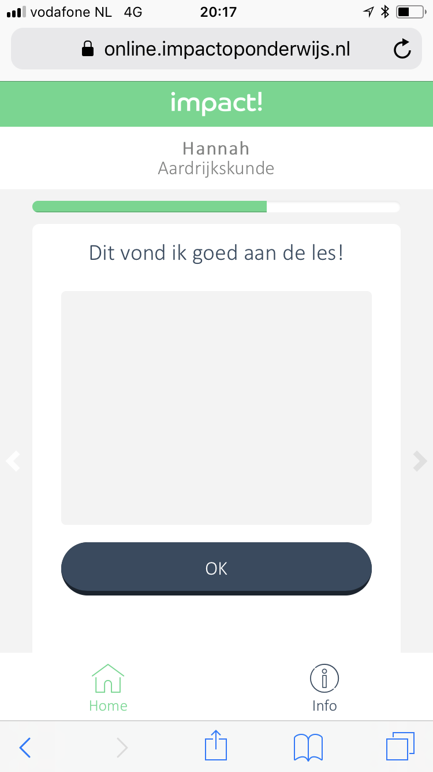
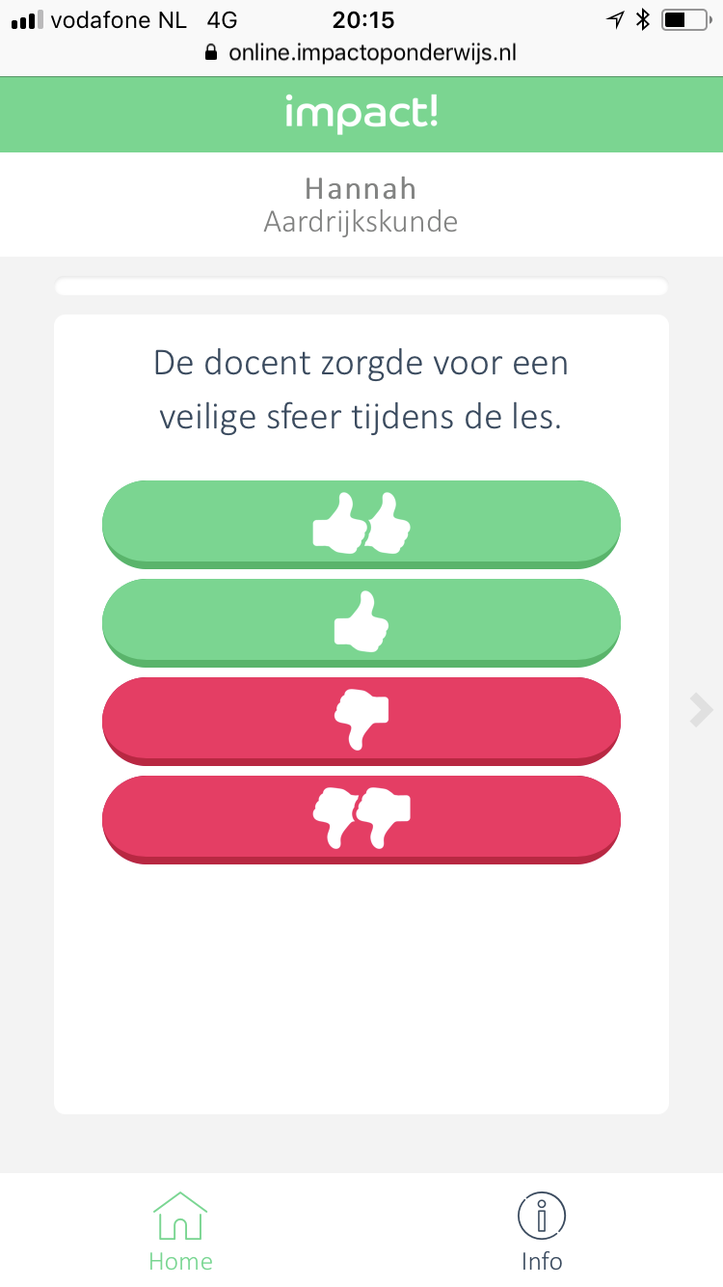
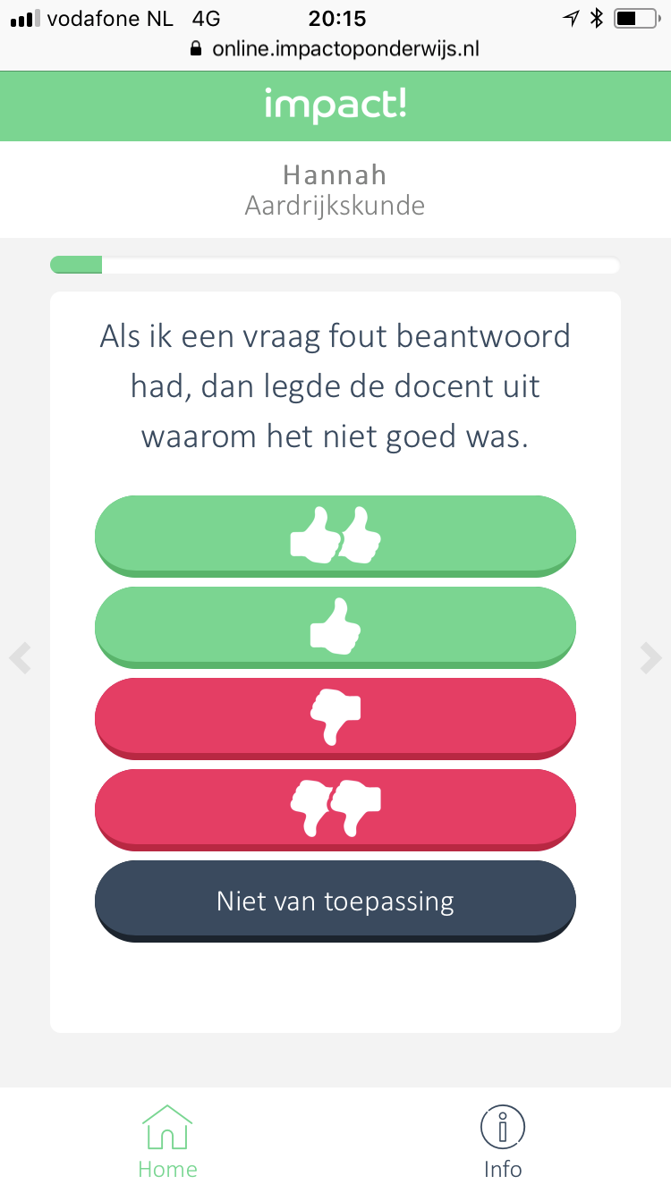
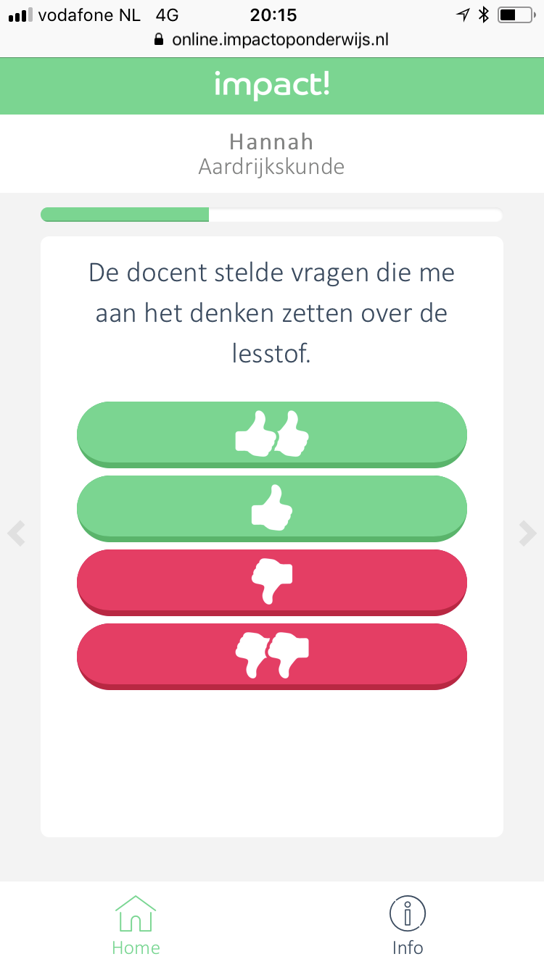
Example: The Impact! tool
Notes:
Items waarop leerlingen hun docent kunnen beoordelen
Bv: Hoge verwachtingen eruit gehaald; dat kunnen leerlingen niet beoordelen.

Slide 22
Feedback to teachers with Impact! tool

Slide 23
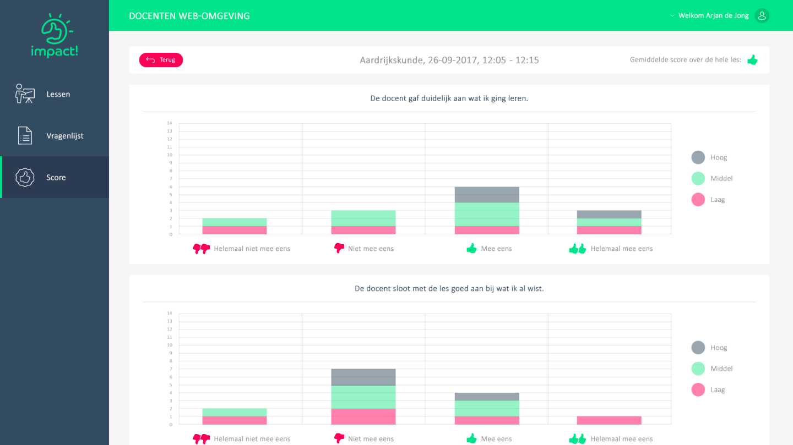
Wat zien docenten?
Score per vraag: in niveaugroepen
Scoreoverzicht docenten
Notes:
Docenten zien scores op verschilende manieren.
Eerste manier is: resultaten van de leerlingen per item, uitgesplitst in niveaugroepen.
Ook: gemiddelde score over de les.

Slide 24
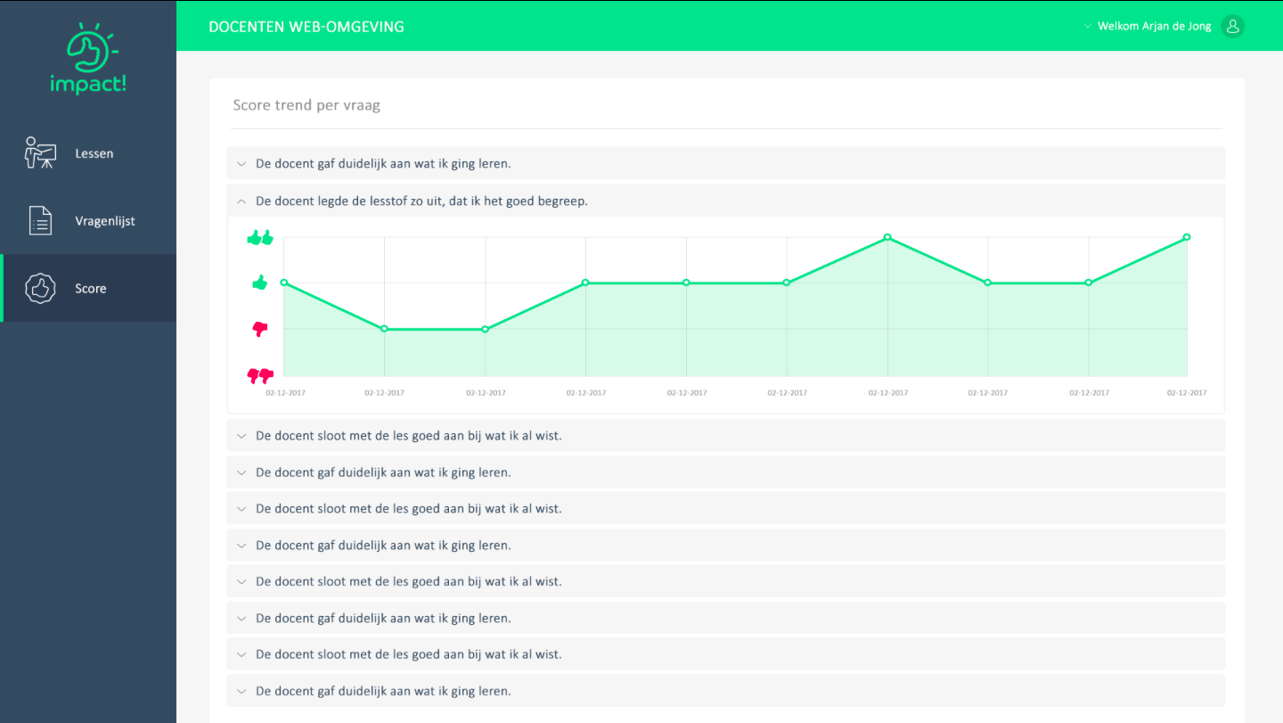
Wat zien docenten?
Score per vraag: in niveaugroepen
Trend over tijd per item
Scoreoverzicht docenten
Notes:
Tweede manier is: per item een trend over de tijd. Ook bij items die je zelf hebt ingevoerd en meerdere keren gebruikt.

Slide 25
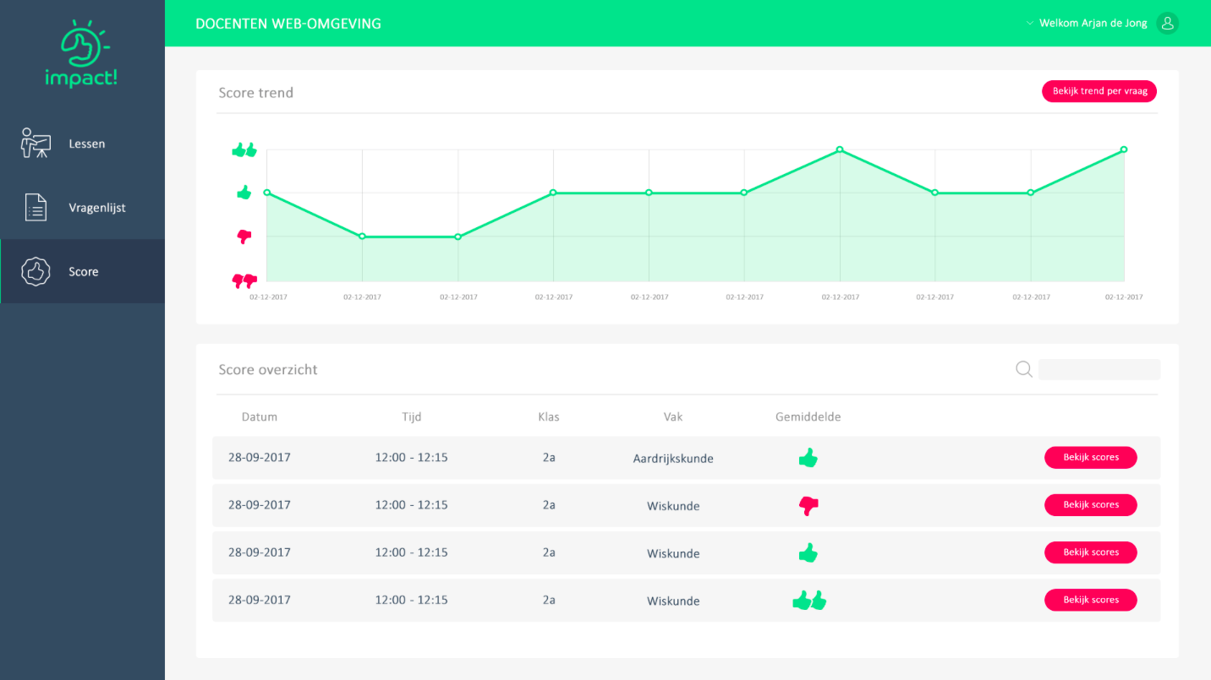
Wat zien docenten?
Score per vraag: in niveaugroepen
Trend over tijd per item
Gemiddelde score per les + trend
Scoreoverzicht docenten
Notes:
Derde manier is: per les de gemiddelde score; en ook de trend over de gemiddelde leskwaliteit van de docent.

Slide 26
ad 4: Human factor in feedback technology
Social science:
feedback acceptation and improvement motivation
organisational ‘support & pressure’
competences for feedback utilization

Slide 27
Equip teachers even better for their complex task by means of …
1. Task analyses -> standaards -> trainings
2. Instruments for feedback
3. Technology <-- human factor
4. School organisation that ‘learns’ and improves
5. Intelligent government: €€€, evidence-based

