Slide 1
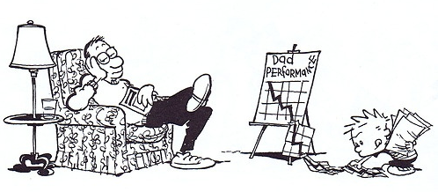
FA & FB in day-to-day practice
Theory, model, tools
Sergej Visser

Slide 2
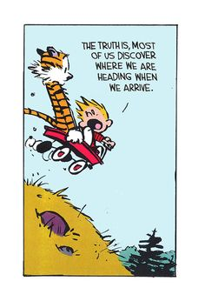
Teaching is the greatest act of optimism.
There is no failure. Only feedback.

Slide 3
Some theory

Slide 4
Improving teaching = understanding learning
What is learning?
Learning = a change in long term memory
How & when do people learn?
Learning happens when people have to think hard.
(Rob Coe)
Thinking happens in the Working Memory.

Slide 5
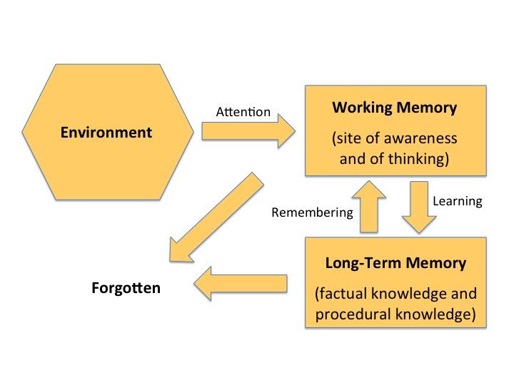
Understanding learning (Daniel Willingham)

Slide 6
We learn when we…
concentrate on relevant examples and non-examples
retrieve content we have previously been taught
apply concepts in new situations / contexts
Practice (focus!)
answer questions on the subject matter
(David Didau)

Slide 7
Starting points
GROW
Goal: learning; next step; development
Routine: instruction; practice; evaluation; feedback; revision
Organise: goals, knowledge, skills, tasks, process, success criteria
Work: Work on what works. Motivation, focus, effort.
Key questions: does it help? Does it work?

Slide 8
Evidence: what works
Effect sizes (Hattie / Marzano)
Pedagogics
Teacher credibility, teacher-student relationship, classroom behavioral
Didactics
Formative assessment, class discussion, feedback, teacher clarity, peer tutoring, collaborative learning, etc.
Treasure trove:
Toolkit for teaching & learning

Slide 9
What works (Robert Coe)
Most promising for raising attainment
8
Feedback
May be worth it
Meta-cognitive
Peer tutoring
Homework (Secondary)
1-1 tuition
Early Years
Effect Size (months gain)
Collaborative
Behaviour
Phonics
Small gp tuition
Parental involvement
Smaller classes
Social
ICT
Individualised learning
Summer schools
After school
Small effects / high cost
Homework (Primary)
Mentoring
Teaching assistants
0
Performance pay
Aspirations
£0
Ability grouping
£1000
Cost per pupil
www.educationendowmentfoundation.org.uk/toolkit

Slide 10
A model

Slide 11
PDCA cycle

Slide 12
FA & FB: model for effective teaching/ learning
Learning goals
Adjustment
Knowledge
Feedback
Skills
Evaluation
Exercise
Implementation

Slide 13
FA & FB: model for effective teaching/ learning
Ambition
Adjustment
Awareness
Advance
Ability
Analysis
Assignment
Action

Slide 14
FA & FB: model for effective teaching/ learning
What will you do?
What will you adjust?
What will you need to know?
What should be improved?
What skills will you need?
How did it go?
How is the task done?
What did you do?

Slide 15
FA & FB: model for effective teaching/ learning
Adjustment
Learning goals
Feedback
Knowledge
Evaluation
Skills
Implementation
Task
Practice
Insight

Slide 16
Insight phase
Learning goals
Adjustment
Knowledge
Feedback
Skills
Evaluation
Assignment
Implementation

Slide 17
Learning goals
WHAT
Explain project
Ask pupils what they think they will (or want to) learn
Formulate learning goals together
HOW
Prepare list of LG: simple, clear, primary goals
Avoid far transfer
Gather student input
Adapt LG list

Slide 18
Insight phase
Learning goals
Adjustment
Knowledge
Feedback
Skills
Evaluation
Assignment
Implementation

Slide 19
Knowledge
WHAT
Specify what pupils need to know to finish the project
Retrieve prior knowledge
Explain new concepts
Link new concepts to prior knowledge
Check understanding of new concept

Slide 20
Knowledge
HOW
Checklist / summary / glossary
Note taking, class discussion, TPS
Relevant examples and non-examples
Practice new knowledge / concept
Check understanding: hinge questions, (formative) tests
Elementary knowledge: fail / pass test

Slide 21
Insight phase
Learning goals
Adjustment
Knowledge
Feedback
Skills
Evaluation
Assignment
Implementation

Slide 22
Skills
WHAT
Specify “can-dos” for the project
Assess pupils’ skills
Specify success criteria
Give relevant examples and non-examples
Practice

Slide 23
Skills
HOW
Checklist can-do-statements: self / peer assessment
Entry test / task
Assessment rubric (pre-flight schedule); checklist (hard criteria)
Videos / hand-ins of top former students
Deliberate practice; focus on single skill / aspect

Slide 24
Insight phase
Learning goals
Adjustment
Knowledge
Feedback
Skills
Evaluation
Assignment
Implementation

Slide 25
Assignment
WHAT
Extensive project: lesson series
Blended learning: online & offline; individual & cooperative tasks
Clear, appealing, open-end tasks
Worked examples
Scaffolding
Feedback + revision
Challenging final tasks

Slide 26
Assignment
HOW
Poetry project / Presentation Skills / Essay Writing
Pairs / groups; individual & collective tasks
Very clear guidelines; student autonomy in content / subject choice
Worked examples: step-by-step solution to a problem or task
Scaffolding: teachers model or demonstrate how to solve a problem, and then step back, offering support as needed
General, repeated tasks + additions (cumulative / specific)
Final tasks show acquired skills + required knowledge

Slide 27
Practice phase
Learning goals
Adjustment
Knowledge
Feedback
Skills
Evaluation
Assignment
Implementation

Slide 28
Implementation
WHAT & HOW
Lesson series: info & feedback on process & progress
Blended learning: online & offline; individual & cooperative tasks
Tasks: in-class & homework
Pupils work; teacher guides activities, checks & coaches
Teacher asks questions
Cooperation ≠ distributing work
Form = cast in stone; content = rich → autonomy.

Slide 29
Practice phase
Learning goals
Adjustment
Knowledge
Feedback
Skills
Evaluation
Assignment
Implementation

Slide 30
Evaluation
WHAT & HOW: formative assessment
Pupil self-evaluation } Hard criteria
Pupil self-evaluation: presentation } Checklist
Peer assessment } Rubric
Assessment by teacher
Formative assessment → feedback; pass / fail

Slide 31
Practice phase
Learning goals
Adjustment
Knowledge
Feedback
Skills
Evaluation
Assignment
Implementation

Slide 32
Feedback culture: what?
GROW
Goal: continuous learning
Routine: practice the habit; structured, regular FB
Organise: clear goals, process, success criteria
Work: ask & answer questions

Slide 33
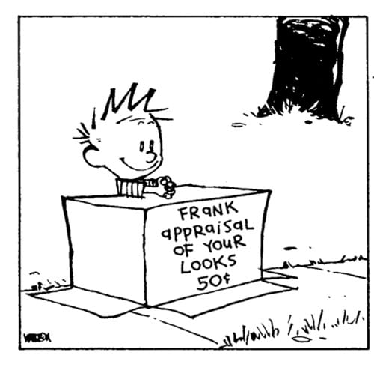
Feedback: how?
Normal, safe & secure
Feed
-up
-back
-forward
Process
Product
Progress

Slide 34
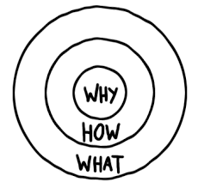
A culture of feedback
Asking for FB is normal for all involved
Focus on personal development / progress
Regular, organized, bilateral FB
Reciprocity

Slide 35
Feedback culture
WHY Involvement, motivation, learning
HOW Example, common cause, reciprocity
WHAT GROW: goals, routines, organisation, work
WHO All involved, starting with teacher

Slide 36
In a feedback culture…
People:
Active
Autonomous
Involved
Inspired
Process:
Continuous
Consistent
Clear
Calculated

Slide 37
Practice phase
Learning goals
Adjustment
Knowledge
Feedback
Skills
Evaluation
Assignment
Implementation

Slide 38
Adjustment
Errors corrected
Teacher indicates & gives FB
Pupil(s) corrects

Slide 39
Some tools

Slide 40
Digital platform: Microsoft Teams
Office 365
Teams → classes
Teams → year groups
Chat room: teachers, students, both
Library
Class Notebook: homework
Tasks & assignments: hand-in, check, feedback

Slide 46
Feedback & Adjustment
LangCorr: Language Correction
For written tasks
Time-saving (however…)
More rich feedback
Formative assessment at its best
https://www.youtube.com/watch?v=llPAafFENsA

Slide 47
Formative assessment: pass / fail
Elemental information:
Adaptive software: training
Testing: Wintoets
Pass/Fail – test: 90% threshold
Grammar
Exam texts
Listening tests
Skills: Assessment rubric
Essay writing
Presentation skills

Slide 48
Formative assessment: pass / fail
Skills: Assessment rubric
Essay writing
Presentation skills
R&J: the play
Music: exam concert
Assessing performance together

Slide 49
Formative assessment: self-evaluation
Presentation:
Reflection on practical assignments
Process
Products
Gains
Next step
Feedback

Slide 50
Concluding: starting points
GROW
Goal: learning; next step; development
Routine: instruction; practice; evaluation; feedback; revision
Organise: goals, knowledge, skills, tasks, process, success criteria
Work: Work on what works. Motivation, focus, effort.
Key questions: does it help? Does it work?

Slide 51
Explore!

